Slide 1

Classification Metrics

Slide 2
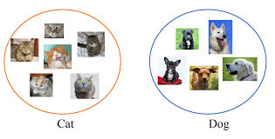

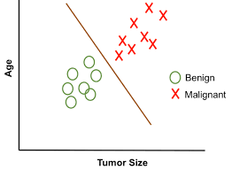
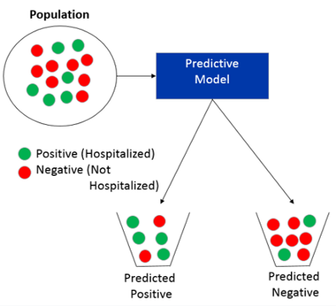

Slide 3
Confusion Matrix
Given an actual label and a predicted label, the first thing we can do is divide our samples in 4 buckets:
True positive — actual = 1, predicted = 1
False positive — actual = 0, predicted = 1
False negative — actual = 1, predicted = 0
True negative — actual = 0, predicted = 0

Slide 4
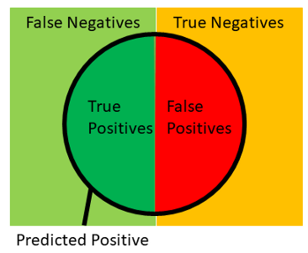
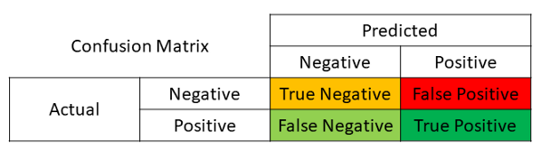
Confusion Matrix

Slide 5
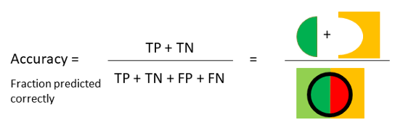
Accuracy Score
The most common metric for classification is accuracy, which is the fraction of samples predicted correctly as shown below:

Slide 6
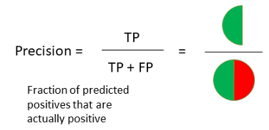
Precision Score
Precision is the fraction of predicted positives events that are actually positive as shown below:

Slide 7
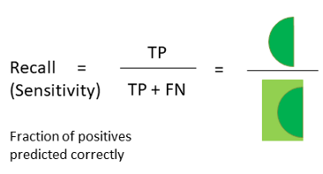
Recall Score
Recall (also known as sensitivity) is the fraction of positives events that you predicted correctly as shown below:

Slide 8
Precision and Recall
Total days – 30 (one month)
Actual rain – 10
Model saying 9 day (5 are correct and 4 are incorrect)
Precision = 5/9 (How many selected item are relevant ? )
Recall = 5/10 (How many relevant items are selected ? )

Slide 9

Precision vs Recall
For example, a cancer hospital has 200 patients where 100 have cancer
A Machine Learning model is retrieving 80 patients and saying that those 80 have cancer and rest of 120 don’t have cancer
Imagine that 40 people out of the 80 patients retrieved by the model have cancer
Precision is 40/80 = 0.5, Recall is 40/100 = 0.4
Now which one is important?

Slide 10
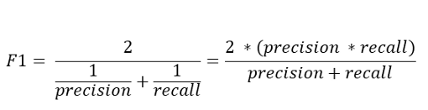
F1 Score
The f1 score is the harmonic mean of recall and precision, with a higher score as a better model. The f1 score is calculated using the following formula:

Slide 11
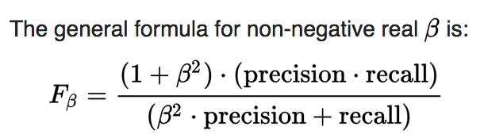
F-β score
F0.5-Measure (beta=0.5): More weight on precision, less weight on recall.
F1-Measure (beta=1.0): Balance the weight on precision and recall.
F2-Measure (beta=2.0): Less weight on precision, more weight on recall

Slide 12
Summary
Precision and recall provide two ways to summarize the errors made for the positive class in a binary classification problem.
F-measure provides a single score that summarizes the precision and recall.
Fbeta-measure provides a configurable version of the F-measure to give more or less attention to the precision and recall measure when calculating a single score.

Slide 13
ROC Curve and ROC AUC Score
ROC curves are VERY help with understanding the balance between true-positive rate and false positive rates. Calculated using 3 lists
thresholds = all unique prediction probabilities in descending order
fpr = the false positive rate (FP / (FP + TN)) for each threshold
tpr = the true positive rate (TP / (TP + FN)) for each threshold
It tells how much model is capable of distinguishing between classes.
Higher the AUC, better the model is at predicting 0s as 0s and 1s as 1s.

Slide 14
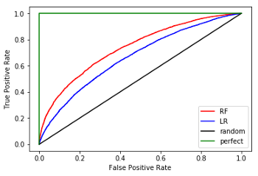

ROC Curve and ROC AUC Score

Slide 15
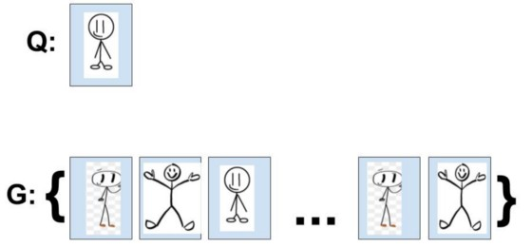

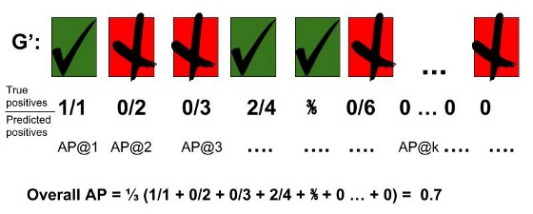
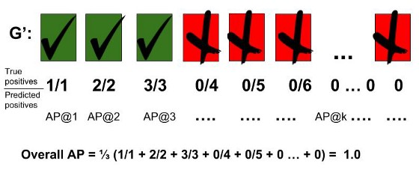
Average Precision
AP@k formula for information retrieval tasks
Calculation of AP for a given query, Q, with a GT=3
Calculation of a perfect AP for a given query, Q, with a GTP=3

Slide 16

Mean Average Precision (mAP)
For each query, Q, we can calculate a corresponding AP. A user can have as much queries as he/she likes against any labelled database. The mAP is simply the mean of all the queries that the use made.
mAP formula for information retrieval

Slide 17
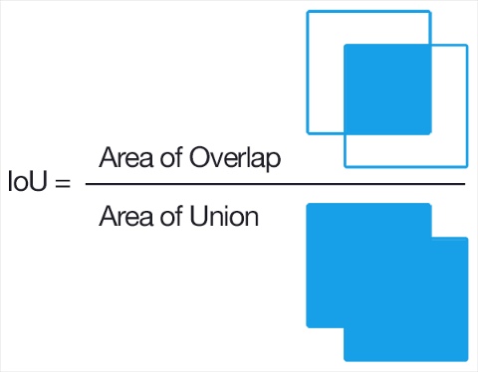
Intersection over Union (IoU)
Useful in object detection and image segmentation problems

Slide 18
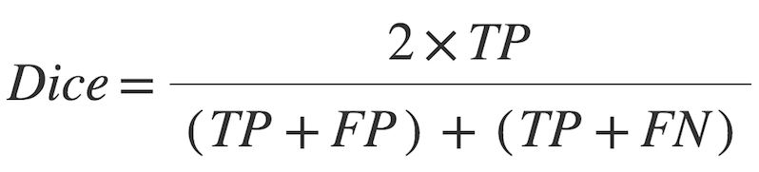
Dice Metric
Notes:
So a few things right off the bat. From the definition of the two metrics, we have that IoU and F score are always within a factor of 2 of each other:
F/2≤IoU≤FF/2≤IoU≤F
and also that they meet at the extremes of one and zero under the conditions that you would expect (perfect match and completely disjoint).Note also that the ratio between them can be related explicitly to the IoU:
IoU/F=1/2+IoU/2IoU/F=1/2+IoU/2
so that the ratio approaches 1/2 as both metrics approach zero.But there's a stronger statement that can be made for the typical application of classification a la machine learning. For any fixed "ground truth", the two metrics are always positively correlated. That is to say that if classifier A is better than B under one metric, it is also better than classifier B under the other metric.
It is tempting then to conclude that the two metrics are functionally equivalent so the choice between them is arbitrary, but not so fast! The problem comes when taking the average score over a set of inferences. Then the difference emerges when quantifying how much worse classifier B is than A for any given case.
In general, the IoU metric tends to penalize single instances of bad classification more than the F score quantitatively even when they can both agree that this one instance is bad. Similarly to how L2 can penalize the largest mistakes more than L1, the IoU metric tends to have a "squaring" effect on the errors relative to the F score. So the F score tends to measure something closer to average performance, while the IoU score measures something closer to the worst case performance.
Suppose for example that the vast majority of the inferences are moderately better with classifier A than B, but some of them of them are significantly worse using classifier A. It may be the case then that the F metric favors classifier A while the IoU metric favors classifier B.
To be sure, both of these metrics are much more alike than they are different. But both of them suffer from another disadvantage from the standpoint of taking averages of these scores over many inferences: they both overstate the importance of sets with little-to-no actual ground truth positive sets. In the common example of image segmentation, if an image only has a single pixel of some detectable class, and the classifier detects that pixel and one other pixel, its F score is a lowly 2/3 and the IoU is even worse at 1/2. Trivial mistakes like these can seriously dominate the average score taken over a set of images. In short, it weights each pixel error inversely proportionally to the size of the selected/relevant set rather than treating them equally.
There is a far simpler metric that avoids this problem. Simply use the total error: FN + FP (e.g. 5% of the image's pixels were miscategorized). In the case where one is more important than the other, a weighted average may be used: c0c0FP + c1c1FN.

